Slide 1
Grocery Purchase App (Farmer Singh)

Slide 2
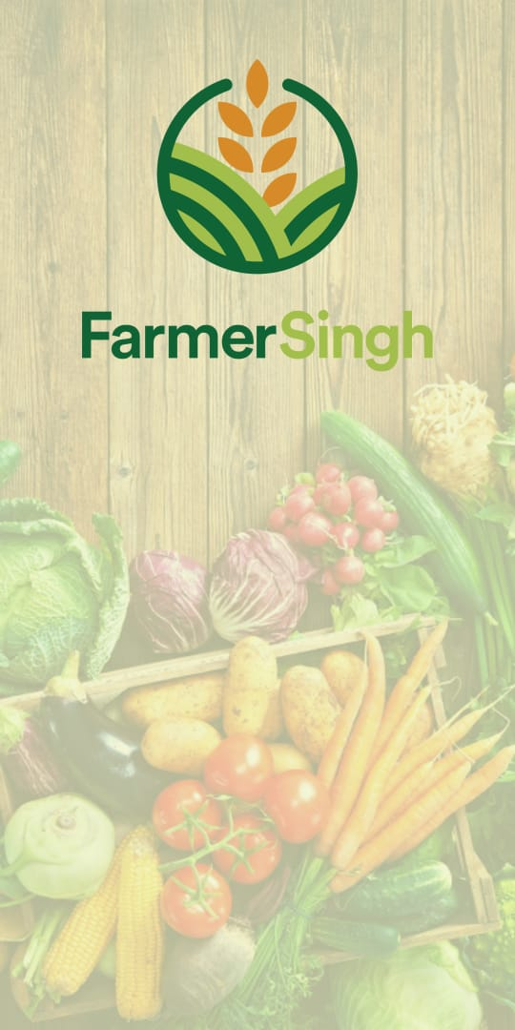
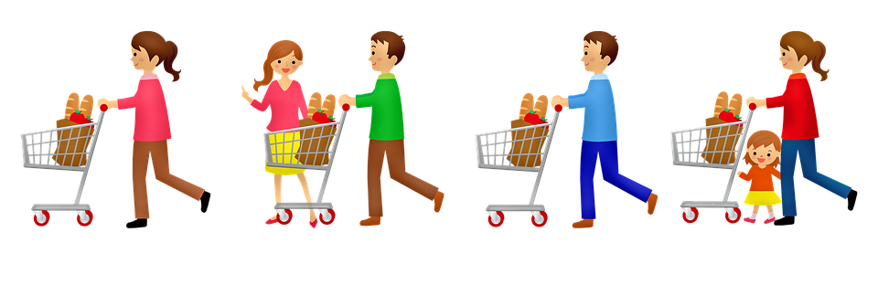
Grocery Purchase App
Farmer Singh

Slide 3
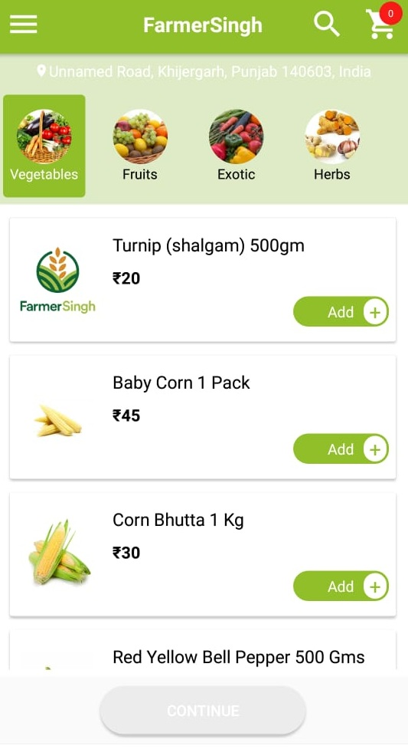
What is Grocery shopping purchase app?
Grocery shopping purchase app allows the users to get all their grocery needs delivered to their doorstep without any inconvenience.
One can easily get their favourite grocery products delivered by just few simple taps on their smart phone.
Whether you want to get your fruits or Corn Bhutta delivered, everything is possible with this single powerful app.

Slide 4
Feature app?
Easily Login
Easily Registration with single Gmail account .
Forget Password with email .
Category List with his products
Just click on add and press continue
Easy Cart Process
Cash on Delivery
Order History

Slide 5
Note
All Screen short are related example of sample.

Slide 6
Technology of Farmer App
The aim is to design a Prototype Grocery store (Farmer Singh) App for the Android and iOS platforms (cross-platform).
We use technology React Native and Node JS for this app.
We are using react native for mobile cross-platfom
We are using mean (mongodb, express, angular, nodejs) for backend

Slide 7
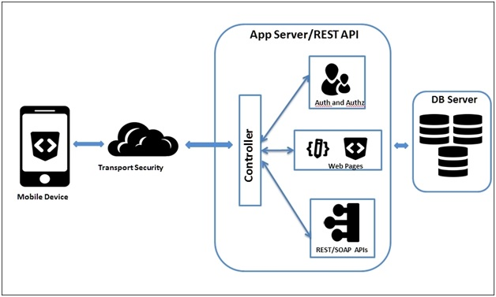
Farmer app connectivity with Server
We are using cloud server (Aws).
For backend development we are using mean mongodb, express, angular, nodejs
Our data store in mongodb database
Our webapis provide a connection between server and app

Slide 8
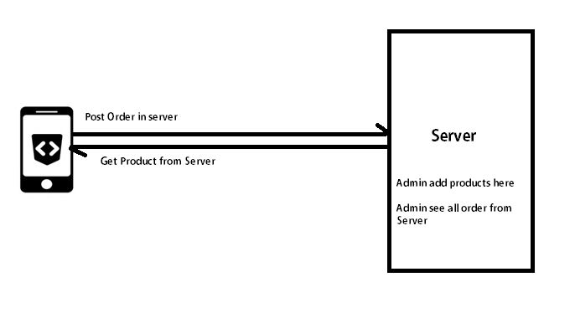
App server connection function
Admin add the product in server by Admin Panel.
Our rest apis fetch these all products in app
We book order from mobile cart and post data in server by rest apis
After admin see all the orders in server and work on this(Like book and send to the customer)

Slide 9
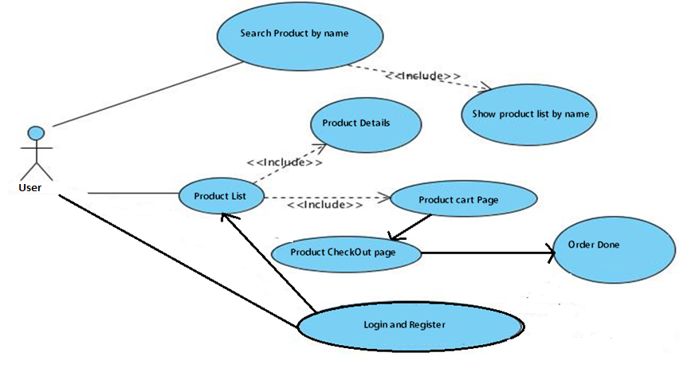
Flow Chart Use Case Diagram for Grocery store App Functions

Slide 10
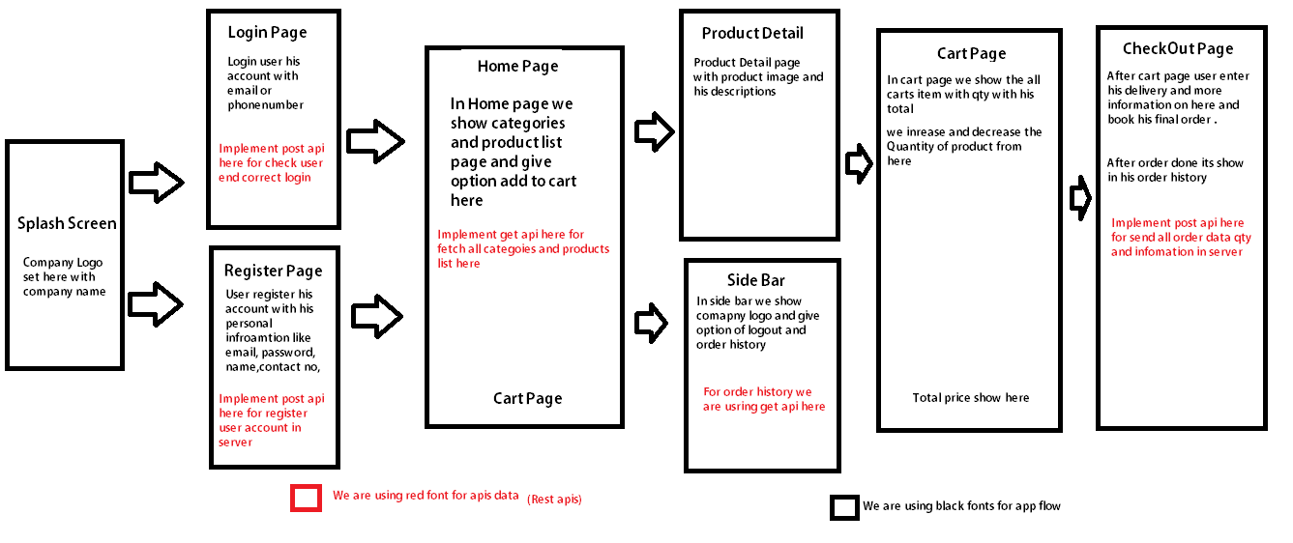
App Flow

Slide 11
External Data Sources (Web Services/API)
Will use the OMDB Web Service to get grocery store data:
Example Request URL:- https://www.example.com/getProductList
Example Response in JSON format:
[
{
“name” : ” tomato”,
“imageurl” : “https://cdn.shopify.com/s/files/1/0871/0950/products/Celebrity_Silo_1024x1024.jpg” ,
“productid”:”12”,
“product_description”:”HighBrid Tomato with best quality”,
“category_id”:”2”
},
{
“name” : ” Mango”,
“imageurl” : “https://cdn.shopify.com/s/files/1/0871/0950/products/Celebrity_Silo_1024x1024.jpg” ,
“productid”:”13”,
“product_description”:”HighBrid Mango with best quality”,
“category_id”:”3”
}
]

Slide 12
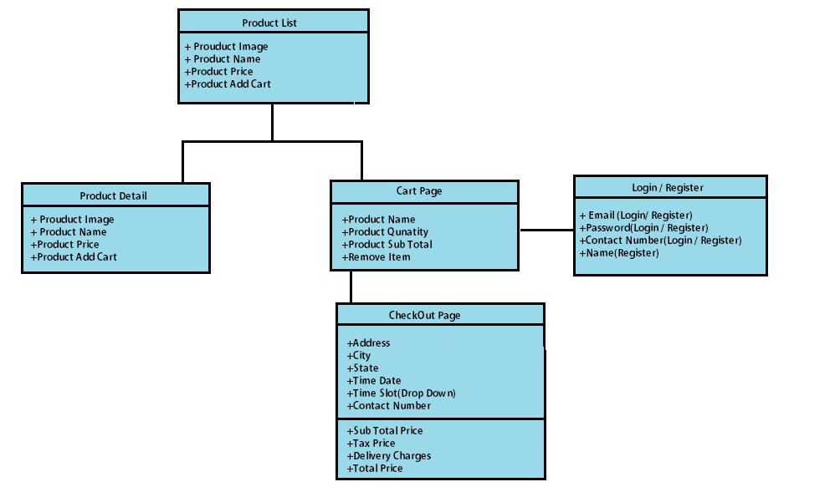
Overall App Design

Slide 13
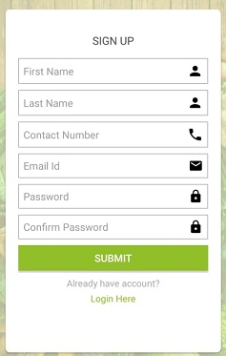
Register
FOR REGISTERATION WE COLLECT USER SOME INFORMATION
FIRST NAME
LAST NAME
EMAIL ID
CONTACT NUMBER
PASSWORD
CONFIRM PASSWORD
JSON DATA PASS AND RESPONSE
Api:- https://www.example.com/register
Pass Data:- {“firstname”:fname,”lastname”:lname,”contact”:contact,”emailid”:email,”password”:password} Response:{“message“:”Successful”} OR {“message”:”already Register”}

Slide 14
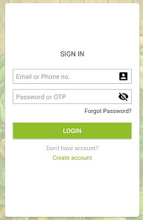
Login
We use email or password and password for login JSON DATA PASS AND RESPONSE
Api:- https://www.example.com/login
Pass Data:- {“emailid”:email,”password”:password} Response:-{“message“:”Successful”,”id”:1,”name”:username,”contact”:99999999,”email”:abc@gmail.com} OR {“message”:”invalid user”}

Slide 15
Products Page
In home page we show categories according products
We give add to cart option on home page
We show the quantity of cart item on home page
We show the current location of app.
We give the search icon in the home page for search all products.
JSON DATA PASS AND RESPONSE
1. Api:- https://www.example.com/categotylist
Response:-[{“id”:1,”cat”,”Vegitable”,”image”:”www.example.com/ss.jpg”},{“id”:2,”cat”,”fruits” ,”image”:”www.example.com/s1s.jpg”}]
2. Api:- https://www.example.com/producttlist
Response:- [{“name” : ” tomato”,“imageurl” : “https://cdn.shopify.com/s/files/1/0871/0950/products/Celebrity_Silo_1024x1024.jpg” ,“productid”:”12”,“product_description”:”HighBrid Tomato with best quality”,“category_id”:”2”},{“name” : ” Mango”,“imageurl” :“https://cdn.shopify.com/s/files/1/0871/0950/products/Celebrity_Silo_1024x1024.jpg” ,“productid”:”13”,“product_description”:”HighBrid Mango with best quality”,“category_id”:”3”}]

Slide 16
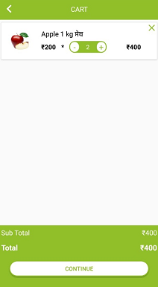
Cart Page
In Cart page we show all cart product that we add in the cart
We show the sub total of products in the cart page
We increase the quantity of items in the cart pages

Slide 17
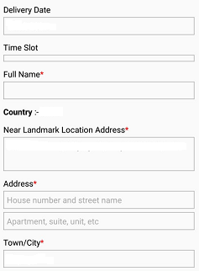
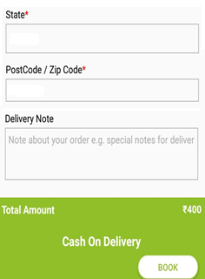
Delivery Information Page
In Delivery page we collect Delivery information from user
Delivery Date
Delivery Slot
Address
Town/City
Near Landmark
Pin code or postal code
Distt
Delivery Note
Book Order
JSON DATA PASS AND RESPONSE
Api:- https://www.example.com/orderdata
Pass Data:- {“deliverydate”:”13-01-2022”,”slottime”:”12:00am”,”address”:”abc”,”town”:”def”,”near_location”,”sddsd”,”distt”:”Def”,”deliverynote”:”test”,”orderdata”:[“id”:”2”,”quantity”:”2”],”total”:400} Response:-{“message“:”Successful”,”id”:1} OR {“message”:”Some Fileds Pending”}

Slide 18
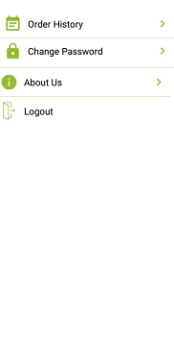
Order History
In Order History we show the all order
All Orders with date time
Order Status(Delivered and Pending)
About Us
In about Us we show the about app
Change Password
In change password we edit password
Logout

Slide 19
App Architecture
Data Source(s):
All Vegetables and fruits collect from google .
The React Architecture allows Web and Mobile apps to share data and state
Will also implement the Singleton design pattern for the connection to the OMDB service
May use the Delegation design pattern for allowing users to tap on a grocery store to view more details…etc

Slide 20
Data Persistence (on/off device)
We will use AsyncStorage for saving user preferences:
That will Works well with both Android and iOS for small data
Uses key: value pairs to store data on device memory:
To Save: AsyncStorage.setItem(‘numItems', this.state.itemCount);
To Read: AsyncStorage.getItem(‘numItems').then(value => this.setState({ getValue: itemCount }));
We will use Redux for saving and managing Vegetables data (web API / local app storage):
Managing data on device mode .
We store all data in local storage if app is in on device internet.
Managing data in off device by local storage.

Slide 21
Conclusion and Perceived Challenges
Download and display of images
Current location of user
Managing cart and quantity of items

Slide 22
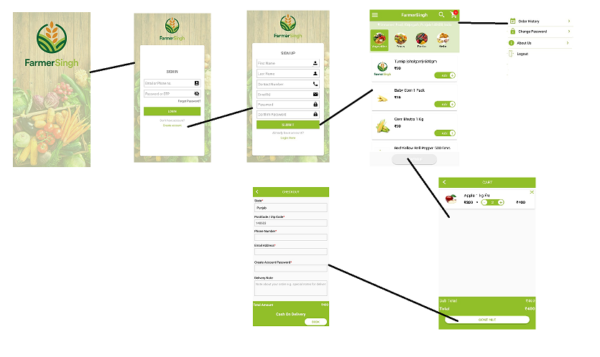
Full Diagram Flow (User Interface Design)

Slide 23

THANK YOU

